Slide 1
AIRFRAME PROGRESS REPORT
Mark Odhiambo & Vivian Mwangi

Slide 2
Github #104[Update of the Rocket in openRocket.]
This is the updated rocket design factoring both the design consideration of both the avionics and flight control.

Slide 3
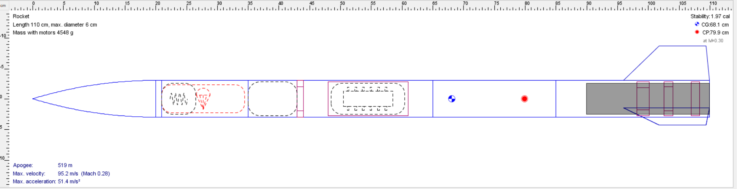

Slide 4
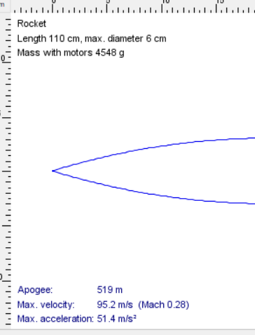

Slide 5
Github #94 Research and fabrication of fins
It was determined that for accuracy the cones will be printed.
This was one of the factors that where considered for the rocket redesign.

Slide 6
Github #105 Rocket recovery system
Different types of deployment.
Single
Dual

Slide 7
Testing of recovery system.
Ground deployment.
After the final configuration of the rocket the final.
The rocket is tested by ground deployment. This is when the rocket is kept to the ground and ejected.

Slide 8
Issues to be done
[Github #106] Third fabrication.
[Github #105] Rocket recovery system

Slide 9
TIMELINE.
WEEK 1-MATERIAL SELECTION, ANALYSIS AND COST
WEEK 2-DESIGN AND SIMULATION.
WEEK 3-SIMULATION CORRECTIONS.
WEEK 4-ASSEMBLY AND FABRICATION.
WEEK 5-ASSEMBLY AND FABRICATION.
WEEK 6- RECOVERY SYSTEM
WEEK 7-FABRICATION.
WEEK 8-TAKE OFF.
PRONE TO CHANGE AS PER THE SITUATION.

